Slide 1
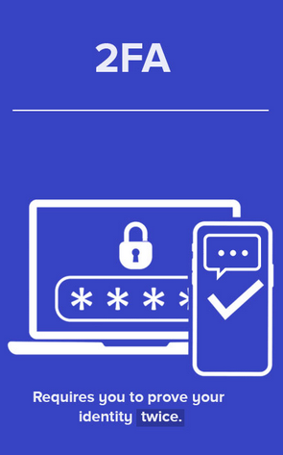

Enabling Multi-Factor authentication
Why?
Risk
How?
Two Factor Authentication, also known as 2FA, is one of the simplest ways to ensure your password is not leaked and will confirm any log in into your account by sending you a confirmation code or any other source of confirmation via call, text, email, etc.
By not using 2FA, you are taking the chance of someone else logging into your account without you knowing. With 2FA, you are ensuring every log in is brought by you to prevent anyone into seeing your personal information by logging in.
How do you enable 2FA? In most social net working sites, or online web services, there will be a settings tab under “My Account” named privacy or security. Within this tab there should be a few ways to enable some sort of 2FA whether it is a third party 2FA like an authentication app or a simple SMS code sent to your phone.
Leaked passwords
preventing
Our over all goal as users of any PC should be to browse safely and accomplish all that we wish but in a safe manner. Make sure to scan your computer often for any viruses. Enable 2FA in all web services and or social media accounts to make sure you are the only user logging in.
Many times, people will never know if their password has been leaked until it is too late. This can lead to hackers seeing personal information. This can be done by keyloggers showing an unwanted user your not-so-secret key phrases.

